Slide 1
Simulation project
Adham Naser 11612293
Mohammed Eshtaya 11440783

Slide 2
Mod2, Question b
What is the effect on carbon reservoirs of various atmospheric carbon dioxide concentrations?
Answer :
Affect positively on terrestrial biosphere
Affect negatively on soil
Doesn’t affect on ocean surface, deep ocean and

Slide 3
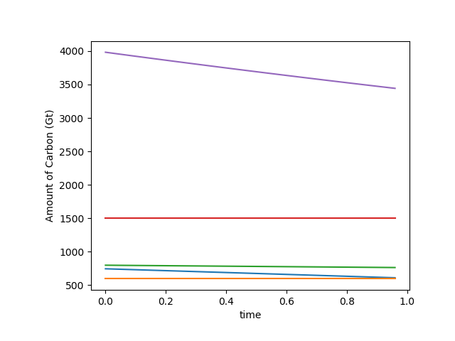
Mod2, Question c
What is the effect of doubling the rate of deforestation or fossil fuel combustion?
Doubling the rate of deforestation will decrease the c

Slide 4
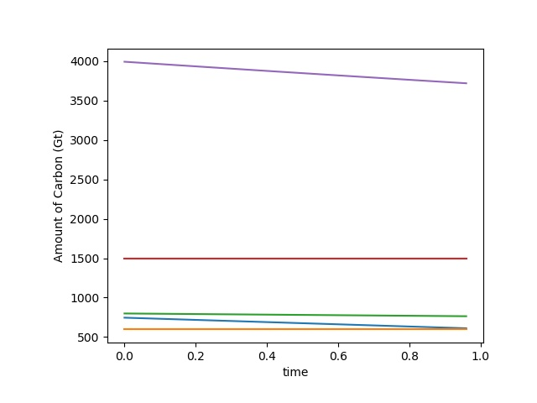
Mod2, Question c
Doubling the rate of combustion will decrease the c
The doubling of deforestation has more affects than the combustion in the decreasing

Slide 5

Mod2, question d
Doubling the rate the deforestation and combustion will be similar to the decreasing of deforestation

